Slide 1
ELECTROCHEMISTRY
Electrochemistry is the study of production of electricity from energy released during spontaneous chemical reactions and the use of electrical energy
to bring about non-spontaneous chemical
transformations.

Slide 2
Redox reactions (quick review)
Oxidation
Reduction
Reducing agent
Oxidizing agent

Slide 3
Redox reactions (quick review)
Oxidation
loss of electrons
Reduction
gain of electrons
Reducing agent
donates the electrons and is oxidized
Oxidizing agent
accepts electrons and is reduced

Slide 4
Redox Reactions
Direct redox reaction
Oxidizing and reducing agents are mixed together

Slide 5
Direct Redox Reaction
Zn rod
CuSO₄(aq) (Cu²⁺)
Deposit of Cu metal forms

Slide 6
Indirect Redox Reactions
Indirect redox reaction
Oxidizing and reducing agents are separated but connected electrically
Example
Zn and Cu²⁺ can be reacted indirectly
Basis for electrochemistry
Electrochemical cell

Slide 7
Electrochemical cell
Device which is used to convert chemical energy into electrical energy is called as electrochemical cell. Eg Daniel Cell.
Cell reaction for this cell is
The electric potential of the cell is 1.1V. If an external opposite potential is applied then cell continue to work in the same way till it reaches potential of 1.1V. After this value it works as electrolytic cell.

Slide 8
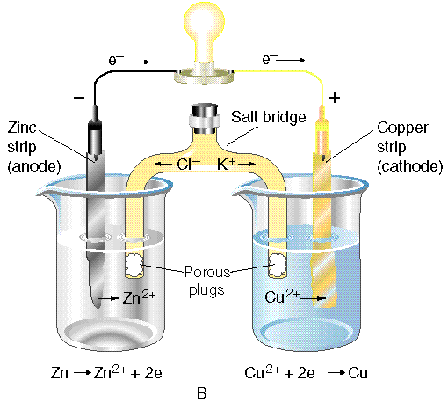
Electrochemical Cells
Voltaic Cell

Slide 9

Galvanic cell
In this device the Gibbs energy of the spontaneous redox reaction is converted into electrical work which may be used for running a motor or other electrical gadgets like heater, fan, geyser, etc. Eg Daniel cell
The redox reaction for Daniel cell is
Half cell reactions are:

Slide 10
These two portions of the cell are also called half-cells or redox couples.
The two half-cells are connected by a metallic wire through a voltmeter and a switch externally. The electrolytes of the two half-cells are connected internally through a salt bridge.
During the reaction A potential difference develops between the electrode and the electrolyte which is called electrode potential.
When the concentrations of all the species involved in a half-cell is unity then the electrode potential is known as standard electrode potential.

Slide 11
In a galvanic cell, the half-cell in which oxidation takes place is called anode and it has a negative potential with respect to the solution. The other
half-cell in which reduction takes place is called cathode and it has a positive potential with respect to the solution. Thus, there exists a potential difference between the two electrodes and as soon as the switch is in the on position the electrons flow from negative electrode
to positive electrode. The direction of current flow is opposite to that of electron flow.

Slide 12

The potential difference between the two electrodes of a galvanic cell is called the cell potential. It is called the cell electromotive force (emf) of the cell when no current is drawn through the cell.
E.M.F of the cell is given by:
Functions of salt bridge:
(1)It completes the electric circuit.
(2)It maintains the electrical neutrality of two half cell solutions.

Slide 13
Cell Representation
Cell Reaction:
Cu_{(s)} + 2Ag⁺_{(aq)}------→ Cu²⁺_{(aq)} + 2Ag_{(s)}
Cell Representation:
Cu_{(s)} | Cu²⁺_{(aq)} || Ag⁺_{(aq)} | Ag_{(s)}

Slide 14
Electromotive Force (emf)
The potential difference between the anode and cathode in a cell is called the electromotive force (emf).
It is also called the cell potential, and is designated E_{cell}.

Slide 15
Electrode Potential
A potential difference develops between the electrode and the electrolyte which is called electrode potential.
The potential difference between the two electrodes of a galvanic cell is called cell potential.

Slide 16
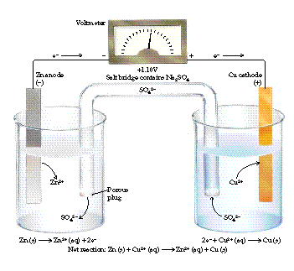
Cell Potential

Slide 17
Cell Potential
Cell Potential (electromotive force), E_{cell} (V)
electrical potential difference between the two electrodes or half-cells
Depends on specific half-reactions, concentrations, and temperature
Under standard state conditions ([solutes] = 1 M, P_{solutes} = 1 atm), emf = standard cell potential, E°_{cell}
1 V = 1 J/C
driving force of the redox reaction

Slide 18
Cell Potential
E_{cell} = E_{cathode} - E_{anode} = E_{redn} - E_{ox}
E°_{cell} = E°_{cathode} - E°_{anode} = E°_{redn} - E°_{ox}
(E_{cathode} and E_{anode} are reduction potentials by definition.)

Slide 19
Measurement of Electrode Potential
The potential of individual half-cell cannot be measured. Because oxidation and reduction do not occur individually.
So arbitrarily we choose one electrode and then find the electrode potential of other by using this electrode. According to convention, a half-cell called standard hydrogen electrode is considered as standard and its value of electrode potential is considered as zero.

Slide 20
Standard hydrogen electrode
The standard hydrogen electrode consists of a platinum electrode coated with platinum black. The electrode is dipped in an acidic solution and pure hydrogen gas is bubbled through it. This electrode can undergo oxidation as well as reduction depending upon the element with which it is combined. Thus it is called as reversible electrode.

Slide 21
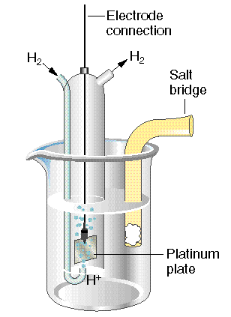
Standard Hydrogen Electrode
E° = 0 V (by definition; arbitrarily selected)
2H⁺ + 2e⁻ → H₂

Slide 22
Cell Representation
At 298 K the emf of the cell, standard hydrogen electrode || second half cell constructed by taking SHE as anode(reference half cell) and other half cell as cathode, gives the reduction potential of the other half cell.
Pt_{(s)}|H₂(g, 1 bar) | H⁺(aq, 1 M) || Cu²⁺(aq, 1 M) | Cu

Slide 23
The positive value of the standard electrode potential in the first case indicates that Cu2+ ions get reduced more easily than H+ ions. Thus we can store HCl in vessel but not in Zn vessel because it has negative value of reduction potential.
HNO₃ cannot be stored in Cu vessel because it is oxidized by nitrate ions not by hydrogen ions.
Some metals like platinum or gold are used as inert electrodes. They do not participate in the reaction but provide their surface for oxidation or reduction reactions and for the conduction of electrons.

Slide 24
In text Questions
Can you Store Copper Sulphate in a zinc Pot?
Given the standard electrode Potential,
K⁺/K = -2.93 V
Ag⁺/ Ag = 0.80 V
Hg⁺/ Hg = 0.79 V
Mg²⁺/ Mg = -2.37 V
Cr³⁺/Cr = -0.74 V
Arrange these metals in their increasing order of reducing power.

Slide 25
Example
Calculate the standard reduction potential of the Ni²⁺ | Ni electrode when the cell potential of the cell Ni | Ni²⁺(1 M) || Cu²⁺ | Cu(1M) is 0.59 V.
( E⁰ Cu²⁺ | Cu = 0.34 V)

Slide 26
Example
A voltaic cell is made by connecting a standard Zn/Zn²⁺ electrode to a S.H.E. The cell potential is 0.76 V. The Zn electrode is the anode of the cell. What is the standard reduction potential of the Zn/Zn²⁺ electrode?

Slide 27
Standard Electrode Potentials
Standard Reduction Potentials, E°
E°_{cell} measured relative to S.H.E. (0 V)
electrode of interest = cathode
If E° < 0 V:
Oxidizing agent is harder to reduce than H⁺
If E° > 0 V:
Oxidizing agent is easier to reduce than H⁺

Slide 28
Electrochemical Series
The arrangement of elements in order of increasing reduction potential values is called as electrochemical series.
Application of electrochemical series:
(1) Relative strength of oxidizing and reducind agents: The substances which have lower value of reduction potential are strong reducing agents while those having higher reduction potential value are strong oxidizing agents.

Slide 29
Standard Reduction Potentials
Reduction Half-Reaction
E°(V)
F₂(g) + 2e⁻ → 2F⁻(aq)
2.87
Au³⁺(aq) + 3e⁻ → Au(s)
1.50
Cl₂(g) + 2 e⁻ → 2Cl⁻(aq)
1.36
Cr₂O₇²⁻(aq) + 14H⁺(aq) + 6e⁻ → 2Cr³⁺(aq) + 7H₂O
1.33
O₂(g) + 4H⁺ + 4e⁻ → 2H₂O(l)
1.23
Ag⁺(aq) + e⁻ → Ag(s)
0.80
Fe³⁺(aq) + e⁻ → Fe²⁺(aq)
0.77
Cu²⁺(aq) + 2e⁻ → Cu(s)
0.34
Sn⁴⁺(aq) + 2e⁻ → Sn²⁺(aq)
0.15
2H⁺(aq) + 2e⁻ → H₂(g)
0.00
Sn²⁺(aq) + 2e⁻ → Sn(s)
-0.14
Ni²⁺(aq) + 2e⁻ → Ni(s)
-0.23
Fe²⁺(aq) + 2e⁻ → Fe(s)
-0.44
Zn²⁺(aq) + 2e⁻ → Zn(s)
-0.76
Al³⁺(aq) + 3e⁻ → Al(s)
-1.66
Mg²⁺(aq) + 2e⁻ → Mg(s)
-2.37
Li⁺(aq) + e⁻ → Li(s)
-3.04

Slide 30
(2) Calculation of E.M.F. of cell:
E⁰_{cell} = E⁰_{cathode}- E⁰_{anode}
(3) Predicting feasibility of the reaction:
(4) To predict whether a metal can librate Hydrogen gas from acids or not: Only those metal can librate Hydrogen from the acid which have negative value of reduction potential.

Slide 31
Differences between electrochemical cell and electrolytic cell
electrochemical cell | electrolytic cell
Cathode positive and anode negative | Cathode negative and anode positive
Device which converts chemical energy to electrical energy | Device which convert electrical energy to chemical energy
Two half cells are set up in different containers | Both the electrodes are placed in same container
Electrons move from anode to cathode | The electrons are supplied by external battery.

Slide 32


Nernst Equation
The concentration of all the species involved in the electrode reaction may not be unity. Nernst showed that for the electrode reaction:
the electrode potential at any concentration measured with respect to standard hydrogen electrode can be represented by:

Slide 33

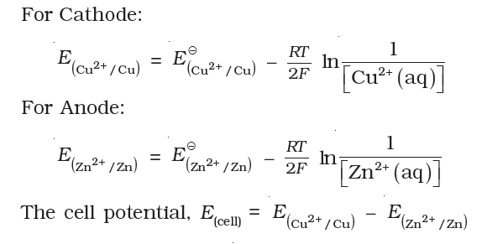
but concentration of solid M is taken as unity and we have
In Daniell cell,

Slide 34
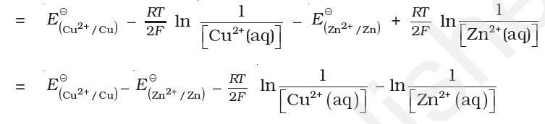


Slide 35

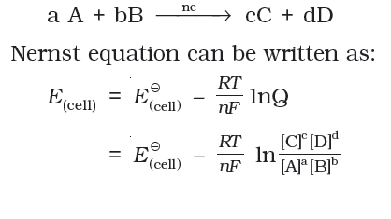
By converting the natural logarithm to the base 10 and substituting the values of R, F and T = 298 K,
for a general electrochemical reaction of the type:

Slide 36
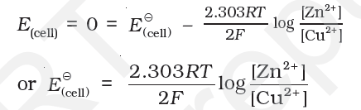


Equilibrium Constant from Nernst Equation
We know that at equilibrium state E_{(cell)} = 0
Thus from Nernst equation of Daniel cell,
At equilibrium
Thus

Slide 37


In general,
Electrochemical Cell and Gibbs Energy of the Reaction:Electrical work done in one second is equal to electrical potential multiplied by total charge passed. If we want to obtain maximum work from a galvanic cell then charge has to be passed reversibly. Thus,

Slide 38


If the concentration of all the reacting species is unity, then
Therefore

Slide 39

Conductance of electrolytic solutions
Electrical resistance: (R): Units- Ohm
The electrical resistance of any object is directly proportional to its length, l, and inversely proportional to its area of cross section, A. That is,
The constant of proportionality, rho is called resistivity (specific resistance). Its SI units are ohm metre (Ω m)

Slide 40

The resistivity for a substance is its resistance when it is one metre long and its area of cross section is one m².
The inverse of resistance, R, is called conductance, G.
The unit of conductance is siemens, equal to ohm^{–1} (also known as mho) or Ω^{–1}.
The inverse of resistivity, called conductivity (specific conductance) is represented by the symbol, к(Greek, kappa).

Slide 41
The SI units of conductivity are S m^{–1} but quite often, k is expressed in S cm^{–1}.
Conductivity of a material is defined as its its conductance when it is 1 m long and its area of cross section is 1 m².
magnitude of conductivity depends on the nature of the material and also depends on the temperature and pressure.
Superconductors are the material with zero resistivity and infinite conductivity. Eg. Metals at very low temp. and some ceramic materials.

Slide 42
Electrical conductance through metals is called metallic or electronic conductance and is due to the movement of electrons. The electronic conductance depends on
(i) the nature and structure of the metal
(ii) the number of valence electrons per atom
(iii) temperature (it decreases with increase of temperature).

Slide 43

Measurement of the Conductivity of Ionic Solutions
Resistance of an ionic solution can be measured by using special designed cell called as Conductivity cell which is available in different designed and shapes.
Basically it consists of two platinum electrodes coated with platinum black. These have area of cross section equal to ‘A’ and are separated by distance ‘l’. Therefore, solution confined between these electrodes is a column of length l and area of cross section A. Thus

Slide 44

The quantity l/A is called cell constant denoted by the symbol, G*. It depends on the distance between the electrodes and their area of cross-section and has the dimension of length^{–1.}
The cell constant, G*, is then given by the equation:
Once the cell constant is determined, we can use
it for measuring the resistance or conductivity of
any solution by using wheat stone bridge.

Slide 45


Once the cell constant and the resistance of the solution in the cell is determined, the conductivity of the solution is given by the equation:
Molar conductivity: Λ_{m}:
units of Λ _{m} are in Sm²mol^{–1}.

Slide 46

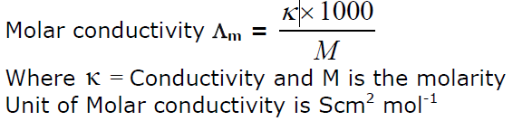
Calculation of Λ _{m} :
1Sm²mol⁻¹ = 10⁴ S cm²mol⁻¹
Molar conductivity of a solution is defined as the conducting power of the ions produced by dissolving 1 mole of an electrolyte in solution.

Slide 47
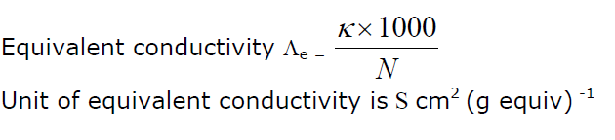
Equivalent conductivity is the conductivity of all the ions produced by dissolving one gram equivalent of an electrolyte in solution.

Slide 48
Variation of conductivity and molar conductivity with concentration
Conductivity always decreases with decrease in concentration both, for weak and strong electrolytes. It is because that the number of ions per unit volume decreases on dilution.
Molar conductivity increases with decrease in concentration. This is because the total volume, V, of solution containing one mole of electrolyte also increases.

Slide 49
When concentration approaches zero, the molar conductivity is known as limiting molar conductivity and is represented by the symbol λ°m.
variation in Λm with concentration for strong electrolyte: For strong electrolytes, Λm increases slowly with dilution and can be represented by the equation:
Λm = λ°m – A c ½

Slide 50
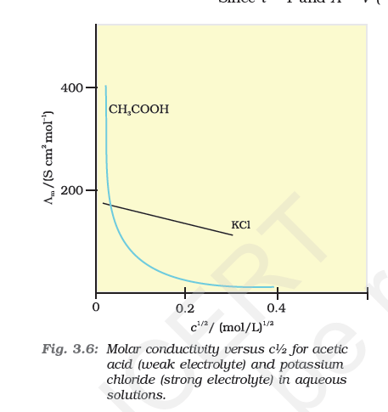

Slide 51
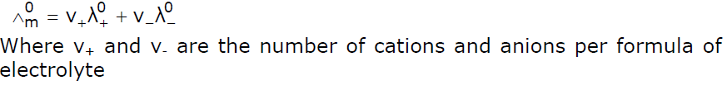
Kohlrausch’s Law of independent migration of ions
According to this law, molar conductivity of an electrolyte, at infinite dilution, can be expressed as the sum of individual contributions from its individual ions. If the limiting molar conductivity of the cations is denoted by λº₊ and that of the anions by λº₋ then the limiting molar conductivity of electrolyte is

Slide 52
variation in Λm with concentration for weak electrolyte: Higher the degree of dissociation, larger is the molar conductance.
With increase in dilution
Degree of dissociation increases as a result molar conductivity increases.
At infinite dilution, the electrolyte is completely dissociated so that the degree of dissociation become one. But at such low concentration the conductivity of the solution is so low that it cannot be measured accurately. So Kohlrausch’s Law of independent migration of ions is used to calculate the λ˚ for weak electrolyte.

Slide 53


At any concentration c if α is the degree of the dissociation then α is given by
Also we know,

Slide 54
Application of Kohlrausch law
Dissociation constant for weak electrolyte
Calculation of Λ˚m from λ˚ of individual electrolyte.

Slide 55
Electrolytic cells and electrolysis
Quantitative Aspects of Electrolysis:
Faraday’s First Law of Electrolysis: The amount of chemical reaction which occurs at any electrode during electrolysis by a current is proportional to the quantity of electricity passed through the electrolyte.
Faraday’s second Law of Electrolysis: The amounts of different substances liberated by the same quantity of electricity passing through the electrolytic solution are proportional to their chemical equivalent weights(

Slide 56

Q = It
Where Q is the quantity of electricity and I is the current passed for time t.
charge on one electron is equal to
1.6021× 10^{–19}C. Therefore, the charge on one mole of electrons is equal to:
This quantity of electricity is called Faraday and is represented by the symbol F and its approximate value is taken as 96500 C /mol

Slide 57
Battery
Batteries are basically electrochemical cells. For a battery to be of practical use it should be reasonably light, compact and its voltage should not vary appreciably during its use.
Types of batteries:
Primary batteries
Secondary batteries

Slide 58
Primary cells. A primary cell is a cell in which electrical energy is produced by the reaction occurring in the cell, e.g. Daniell cell, dry cell, mercury cell. It cannot be recharged.
Dry cell: The cell consists of a zinc container that also acts as anode and the cathode is a carbon (graphite) rod surrounded by powdered manganese dioxide and carbon. The space between the electrodes is filled by a moist paste of ammonium chloride (NH₄Cl) and zinc chloride (ZnCl₂).

Slide 59
Reactions for dry cell are:
At anode : Zn(s) → Zn²⁺ (aq) + 2e⁻
At cathode : MnO₂(s) + NH₄⁺(aq) +e⁻ → MnO(OH) + NH₃
The net reaction:
Zn + NH₄⁺ (aq) + MnO₂ (s) → Zn²⁺ + MnO (OH) + NH₃
Mercury cell: consists of zinc – mercury amalgam as anode and a paste of HgO and carbon as the cathode. The electrolyte is a paste of KOH and ZnO. The electrode reactions for the cell are given below:
At anode : Zn (Hg) + 2OH⁻ → ZnO(s) + H₂O + 2e⁻
At cathode : HgO(s) +H₂O + 2e⁻ → Hg(l) + 2OH⁻
The net reaction : Zn (Hg) + HgO(s) → ZnO(s) + Hg(l)

Slide 60
Secondary Batteries
Those cells which are used for storing electricity, e.g., lead storage battery, nickel – cadmium cell. They can be recharged.
Lead storage battery : It consists of a lead anode and a grid of lead packed with lead dioxide (PbO₂ ) as cathode. A 38% solution of sulphuric acid is used as an electrolyte.
Cell reactions are:
Anode : Pb(s) + SO₄²⁻(aq) → PbSO₄(s) + 2e⁻
Cathode: PbO₂(s) + SO₄²⁻(aq) + 4 H⁺(aq) + 2e⁻ → PbSO₄(s)+ 2H₂O (l)
The overall cell reaction consisting of cathode and anode reactions is:
Pb(s) + PbO₂(s) + 2H₂SO₄(aq) → 2PbSO₄(s) + 2H₂O(l)
On recharging the battery, the reaction is reversed.

Slide 61
Nickel-cadmium cell: it has longer life than the lead storage cell but more expensive to manufacture.
The overall reaction during discharge is:
Cd(s) + 2 Ni(OH)₃(s) → CdO(s) + 2Ni(OH)₂(s) + H₂O(l)
Fuel Cells: Galvanic cells that are designed to convert the energy of combustion of fuels like hydrogen, methane, methanol, etc. directly into electrical energy are called fuel cells.

Slide 62
One of the most successful fuel cells uses the reaction of hydrogen with oxygen to form water.
In the cell, hydrogen and oxygen are bubbled through carbon electrodes into concentrated aqueous sodium hydroxide solution. Catalysts like finely divided platinum or palladium metal are incorporated into the electrodes for increasing the rate of electrode reactions. The electrode reactions are given below:
At anode : 2 H₂(g) + 4OH⁻ (aq) → 4H₂O(l) + 4e⁻
At cathode : O₂(g) + 2H₂O(l) + 4e⁻ → 4 OH⁻(aq)
Overall reaction:
2 H₂(g) + O₂(g) → 2H₂O(l)
Fuel cells are pollution free and in view of their future importance, a variety of fuel cells have been fabricated and tried.

Slide 63
Corrosion
In corrosion, a metal is oxidized by loss of electrons to oxygen and formation of oxides. Corrosion of iron (commonly known as rusting) occurs in presence of water and air. The chemistry of corrosion is quite complex but it may be considered essentially as an electrochemical phenomenon.
At a particular spot of an object made of iron, oxidation takes place and that spot behaves as anode. Electrons released at anodic spot move go to another spot on the metal and reduce oxygen in presence of H⁺ and his spot behaves as cathode.

Slide 64
Reactions for corrosion:
Oxidation: Fe(s) → Fe²⁺ (aq) + 2e⁻
Reduction: O²(g) + 4H⁺ (aq) + 4e⁻ → 2H²O(l)
The overall reaction is
Ferrous ions are further oxidized by the atmospheric oxygen to form Fe₂O₃ which is hydrated as Fe₂O_{3.} xH₂O

